Slide 1
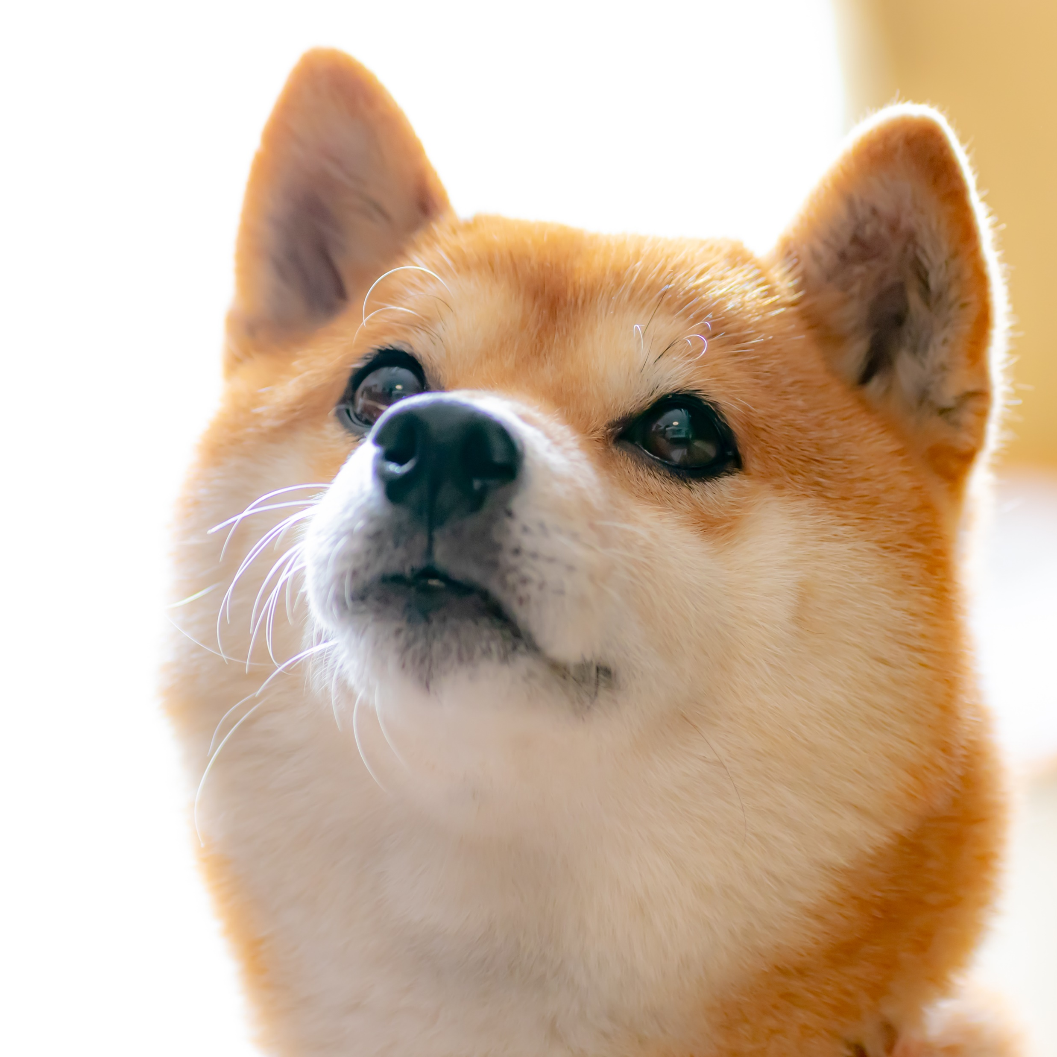
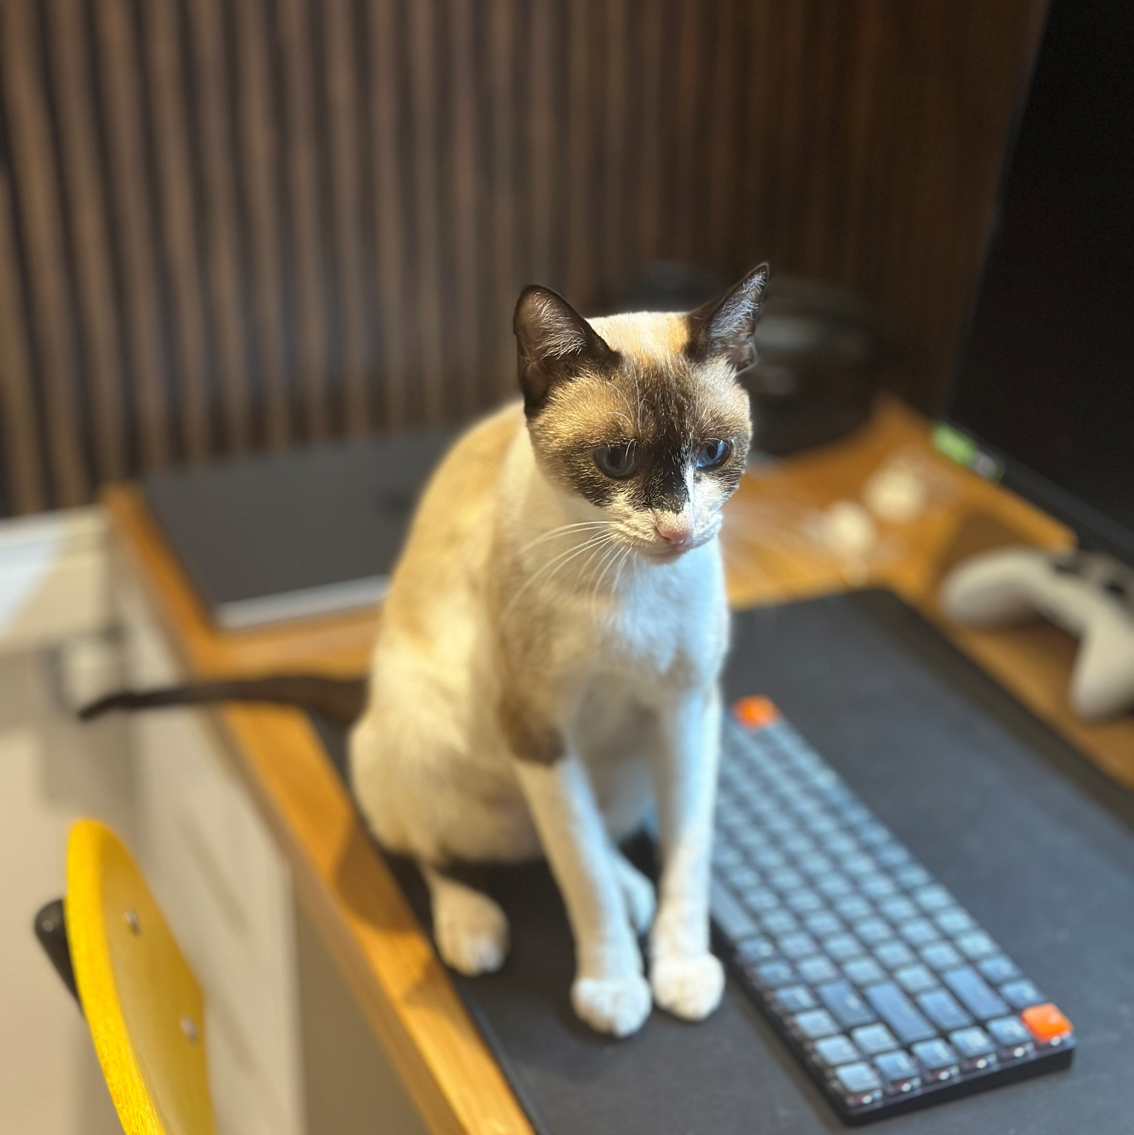
Pets Adoption
1st Cat
2nd Cat
3rd Cat
4th Cat
Code
Pet
Specie
Breed
Fee
Elapsed time
Status
01458
Speedy
Dog
Labrador
$ 50,00
8 Days
Payment
01459
Speedy
Dog
Labrador
$ 50,00
8 Days
Payment
01458
Kat
Cat
Siamese
$ 50,00
8 Days
Pending
01459
Kat
Cat
Siamese
$ 50,00
8 Days
Pending
01458
Kat
Cat
Siamese
$ 50,00
8 Days
Pending
01459
Kat
Cat
Siamese
$ 50,00
8 Days
Pending
01458
Kat
Cat
Siamese
$ 50,00
8 Days
Pending
01459
Kat
Cat
Siamese
$ 50,00
8 Days
Pending
01458
Kat
Cat
Siamese
$ 50,00
8 Days
Pending
01459
Kat
Cat
Siamese
$ 50,00
8 Days
Pending
01458
Kat
Cat
Siamese
$ 50,00
8 Days
Pending
01459
Kat
Cat
Siamese
$ 50,00
8 Days
Pending

Slide 2
Pets Adoption
1st Cat
2nd Cat
3rd Cat
4th Cat
Code
Pet
Specie
Breed
Fee
Elapsed time
Status
01458
Speedy
Dog
Labrador
$ 50,00
8 Days
Payment
01459
Speedy
Dog
Labrador
$ 50,00
8 Days
Payment
01458
Kat
Cat
Siamese
$ 50,00
8 Days
Pending
01459
Kat
Cat
Siamese
$ 50,00
8 Days
Pending
01458
Kat
Cat
Siamese
$ 50,00
8 Days
Pending
01459
Kat
Cat
Siamese
$ 50,00
8 Days
Pending
01458
Kat
Cat
Siamese
$ 50,00
8 Days
Pending
01459
Kat
Cat
Siamese
$ 50,00
8 Days
Pending
01458
Kat
Cat
Siamese
$ 50,00
8 Days
Pending
01459
Kat
Cat
Siamese
$ 50,00
8 Days
Pending
01458
Kat
Cat
Siamese
$ 50,00
8 Days
Pending
01459
Kat
Cat
Siamese
$ 50,00
8 Days
Pending

